Slide 1

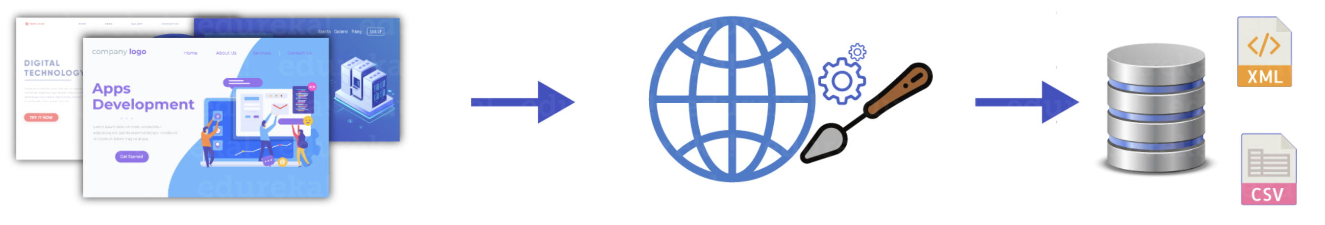







Data Ops
Webpages
Web Scraping
Structured Data
Cleaning data & features selection
BI Report
Data pipeline control & flow automation
ML Ops
Model Training
Convolution neural network
Images data
Exploratory Data Analysis & Split data to (Train/Test/Validation)
Model Training
Natural Language Processing
Comment data

Slide 2
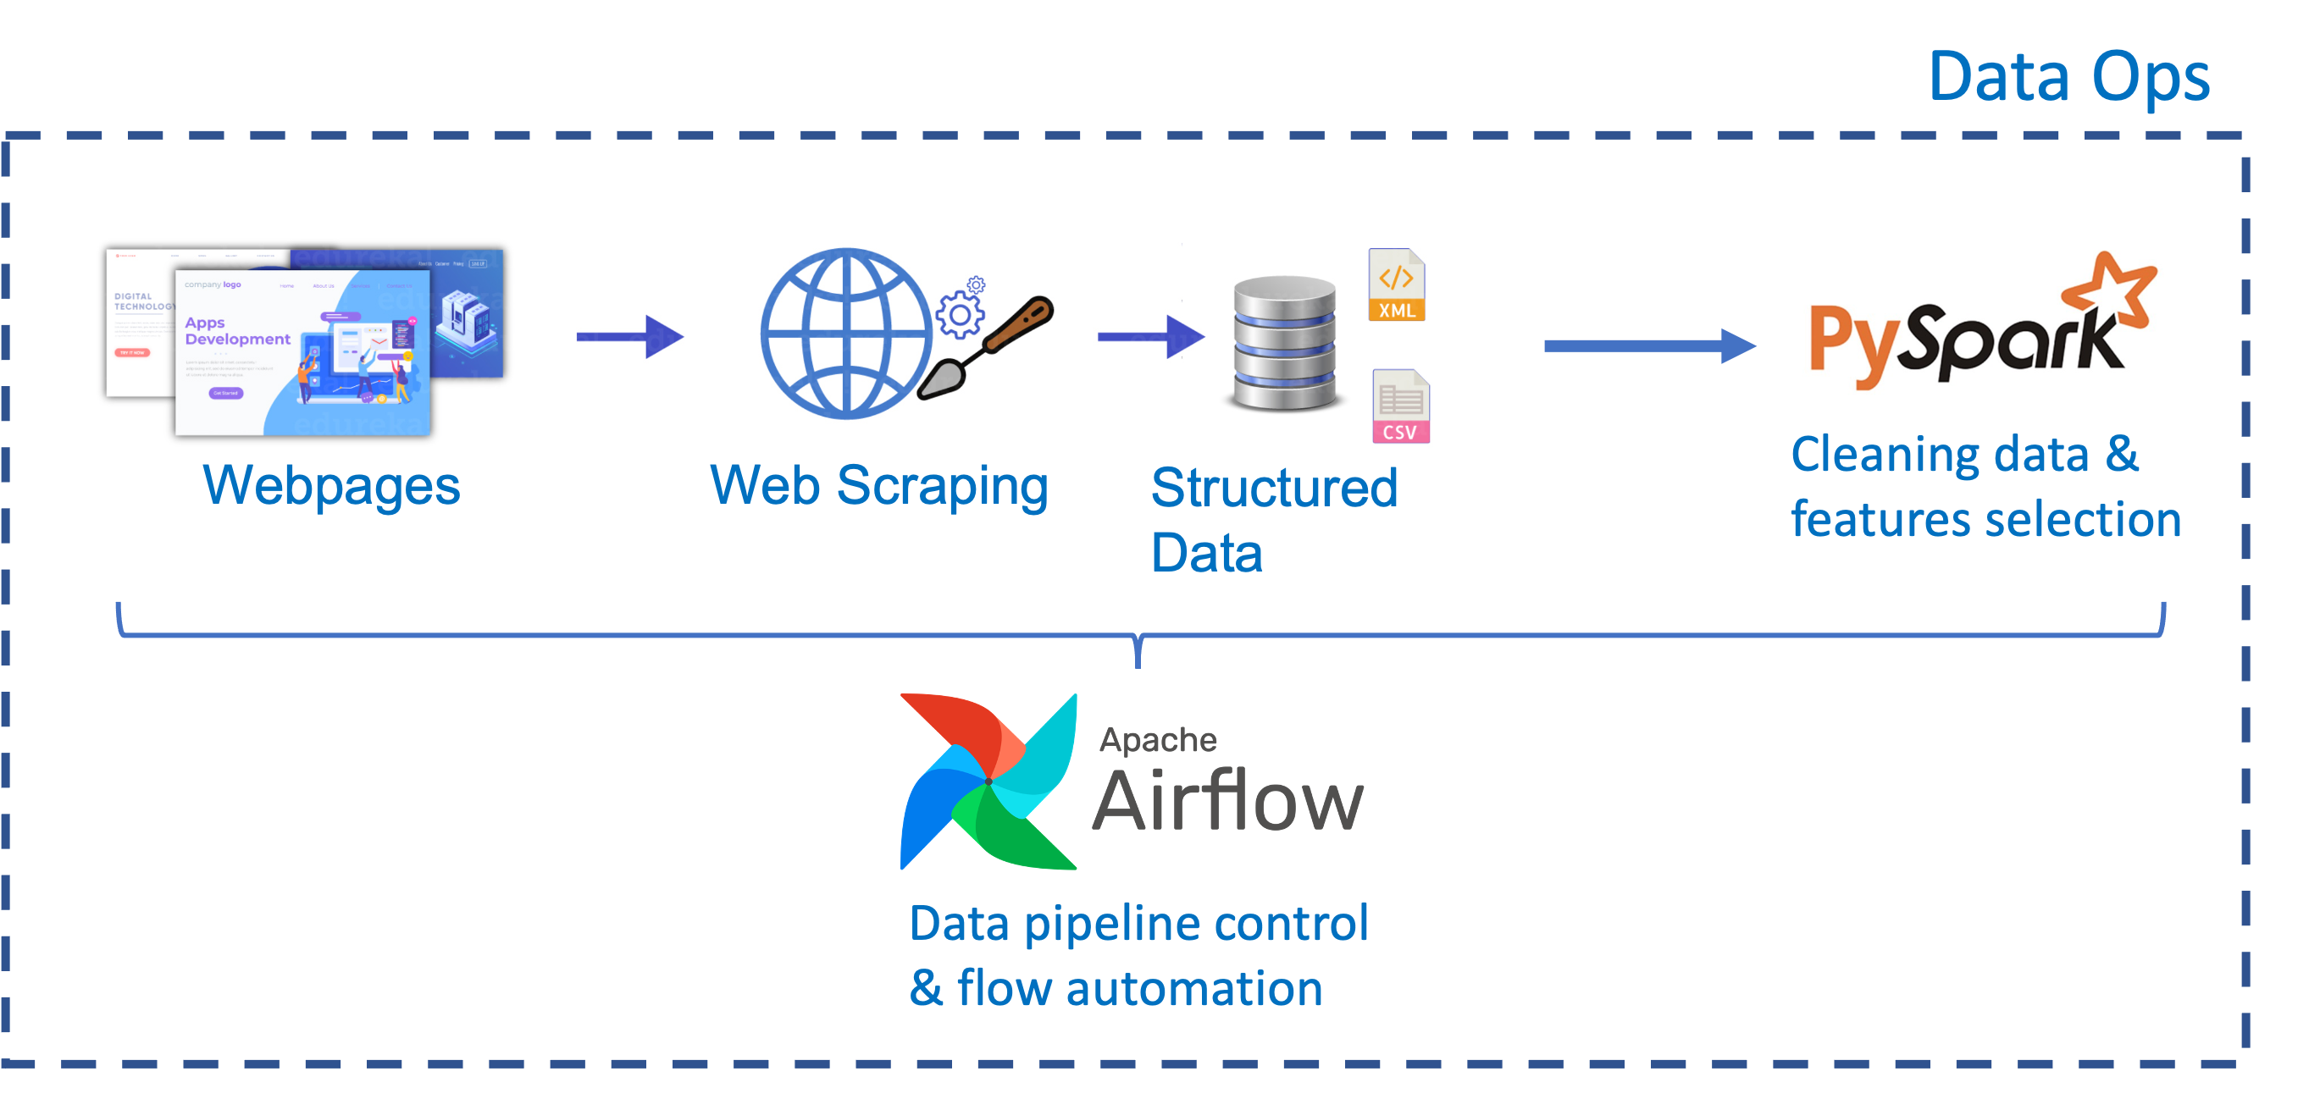
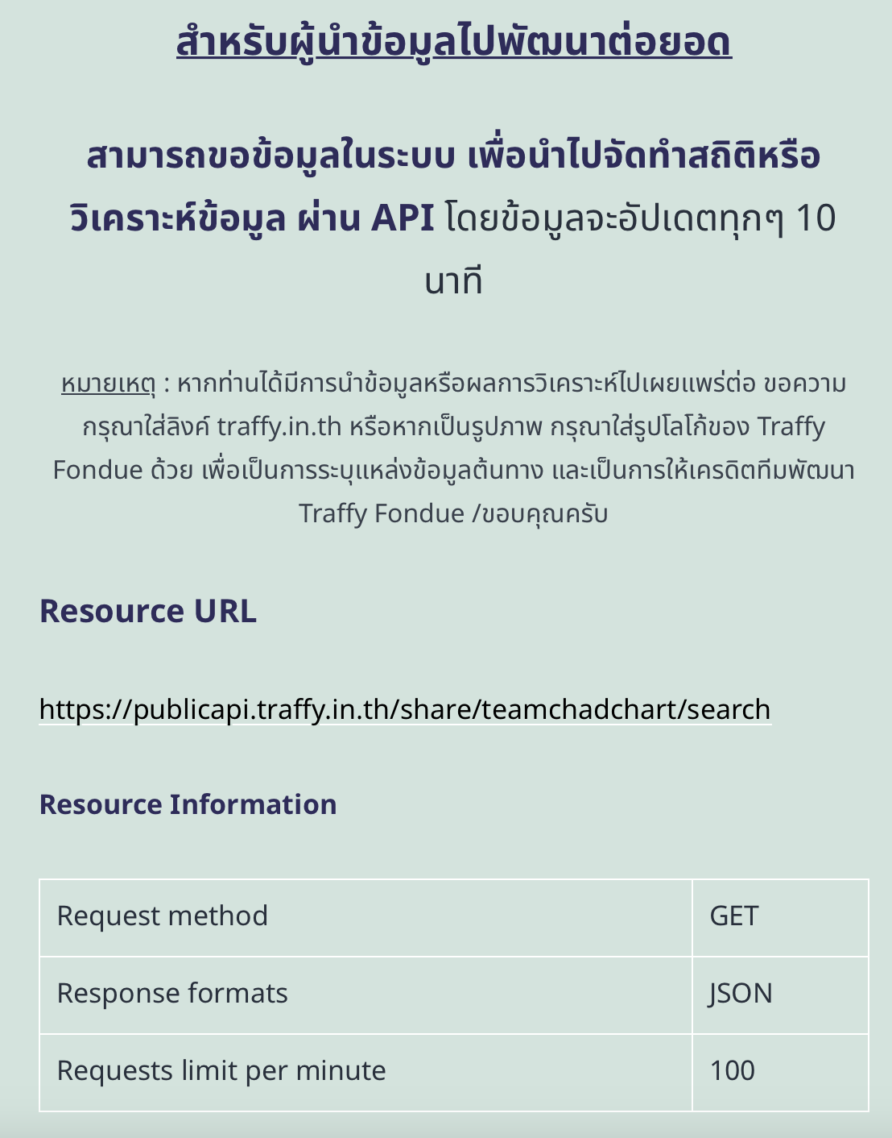
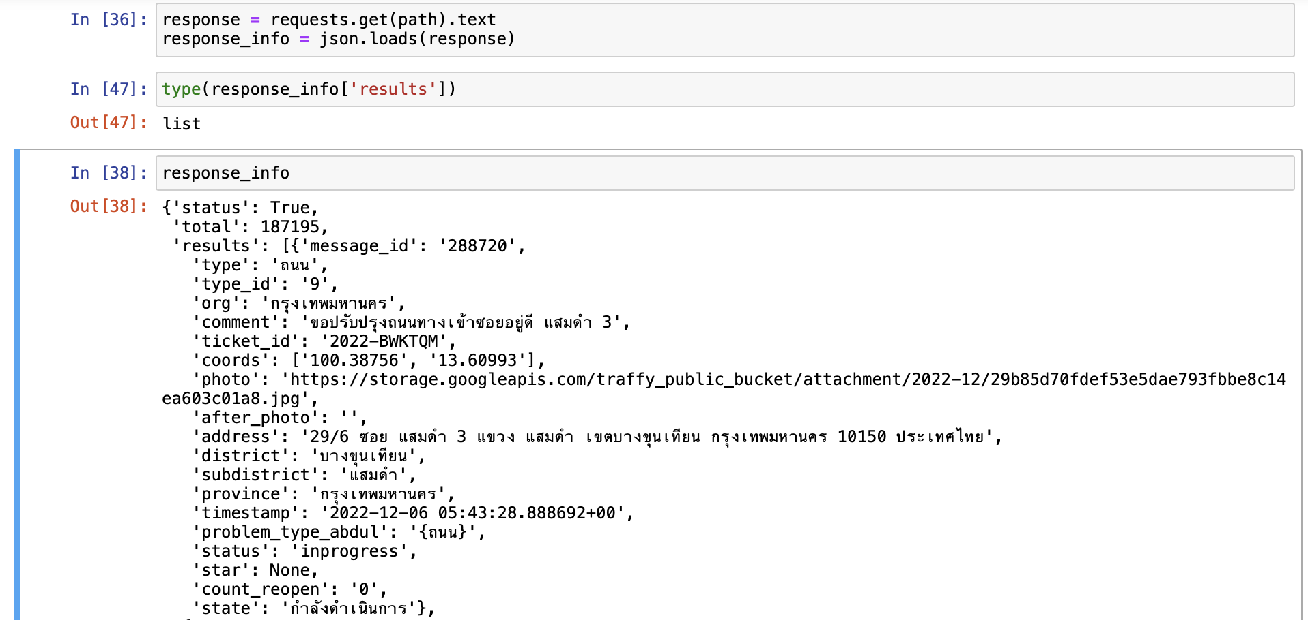
Web Scraping
Using Traffy Fondue API
Example of data (JSON)
https://www.traffy.in.th/?page_id=27351

Slide 3
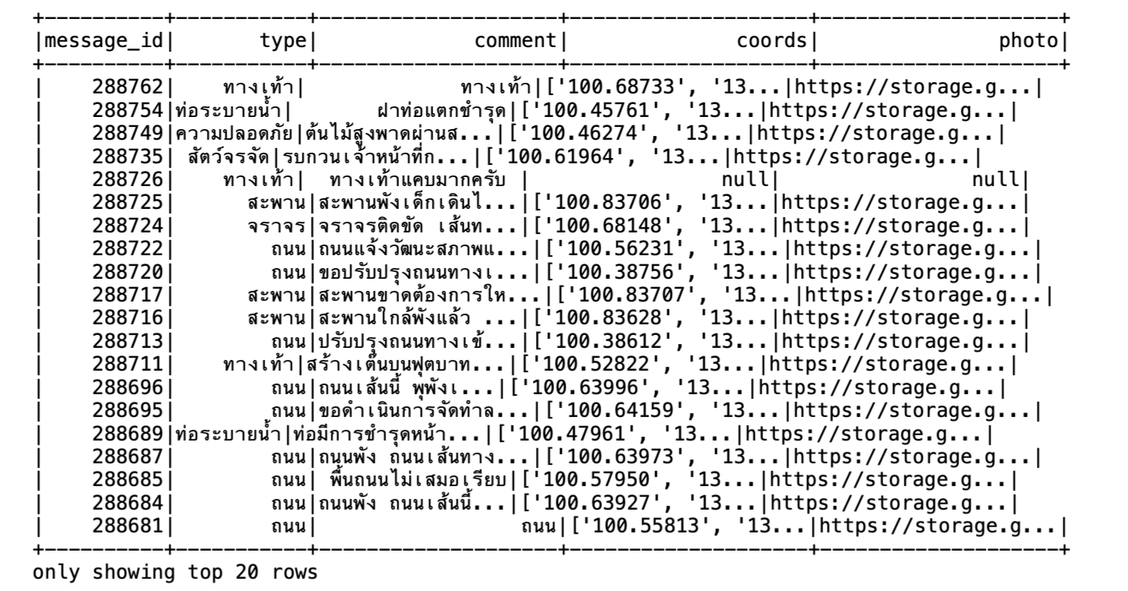
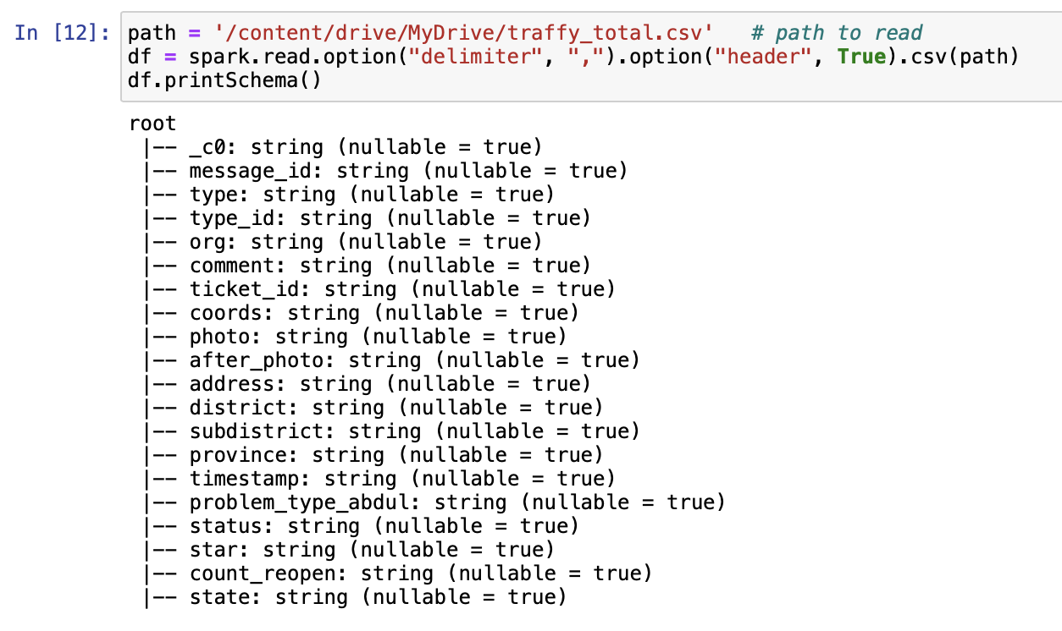
Cleaning Data & Feature selection
Data after remove missing values and features selection for machine learning models
List of Traffy Fondue data column

Slide 4
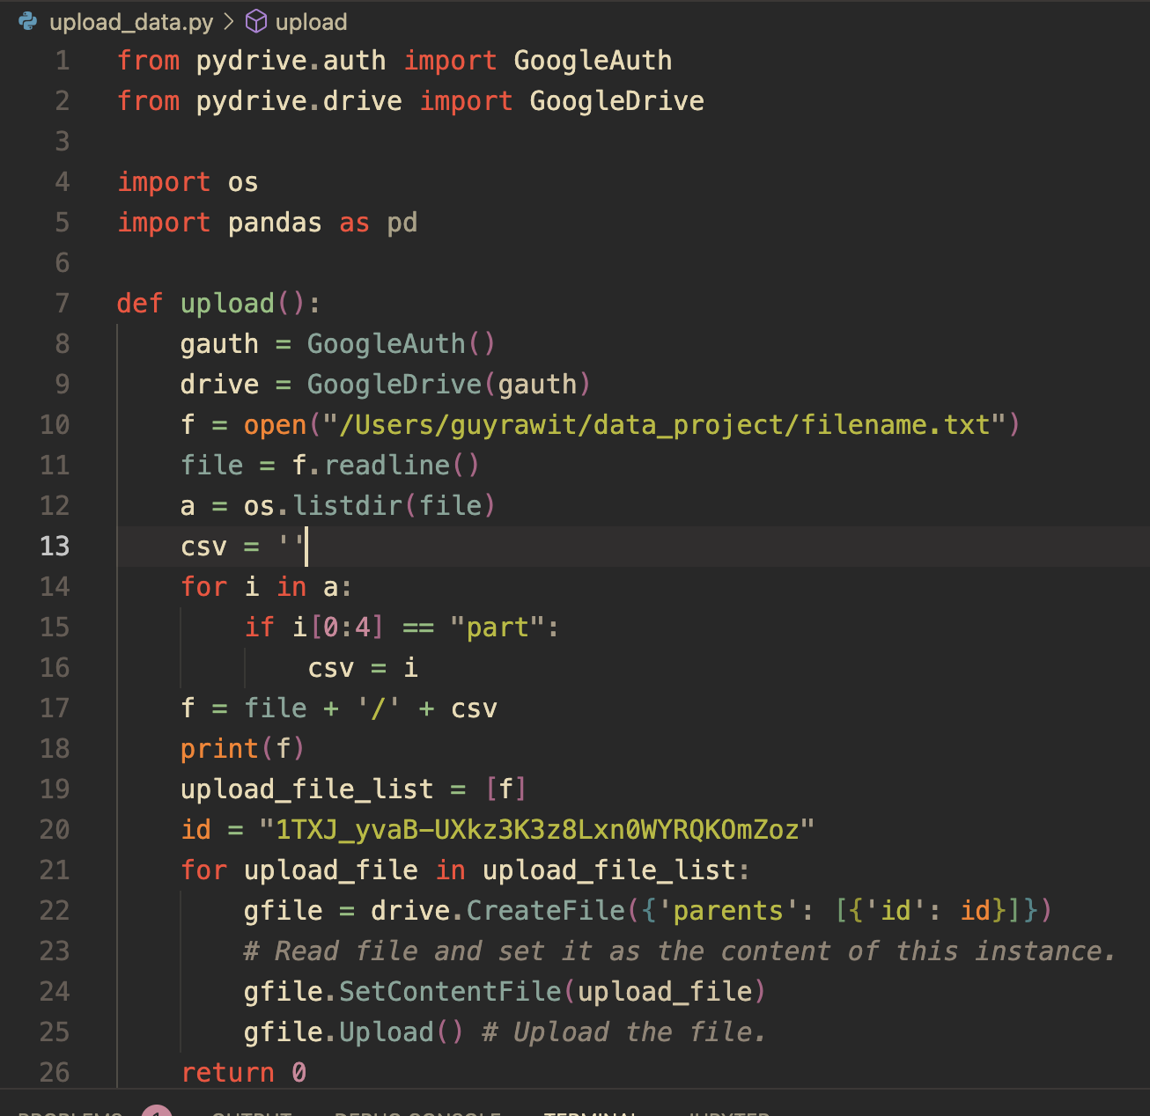

Data Preparation
Upload via google cloud API
From local
From local

Slide 5
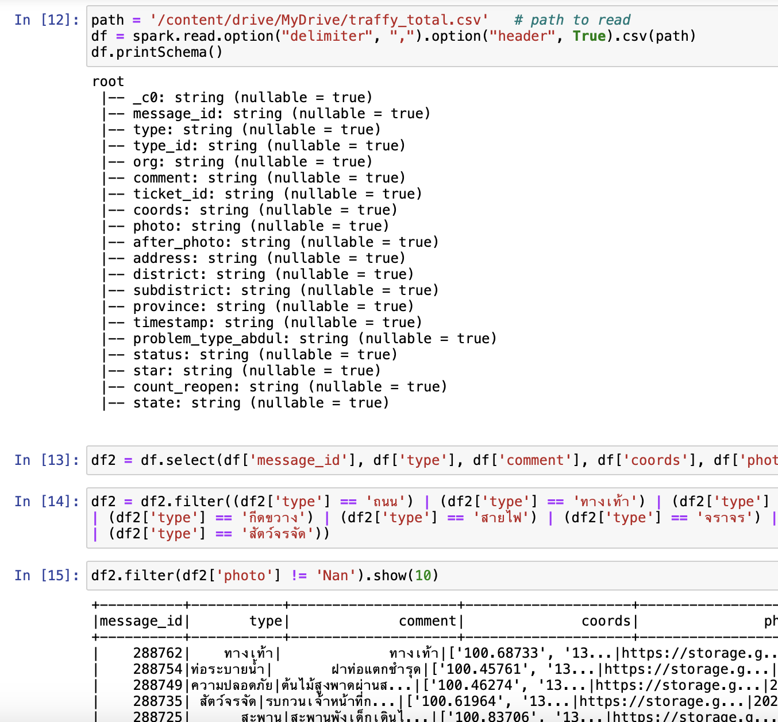
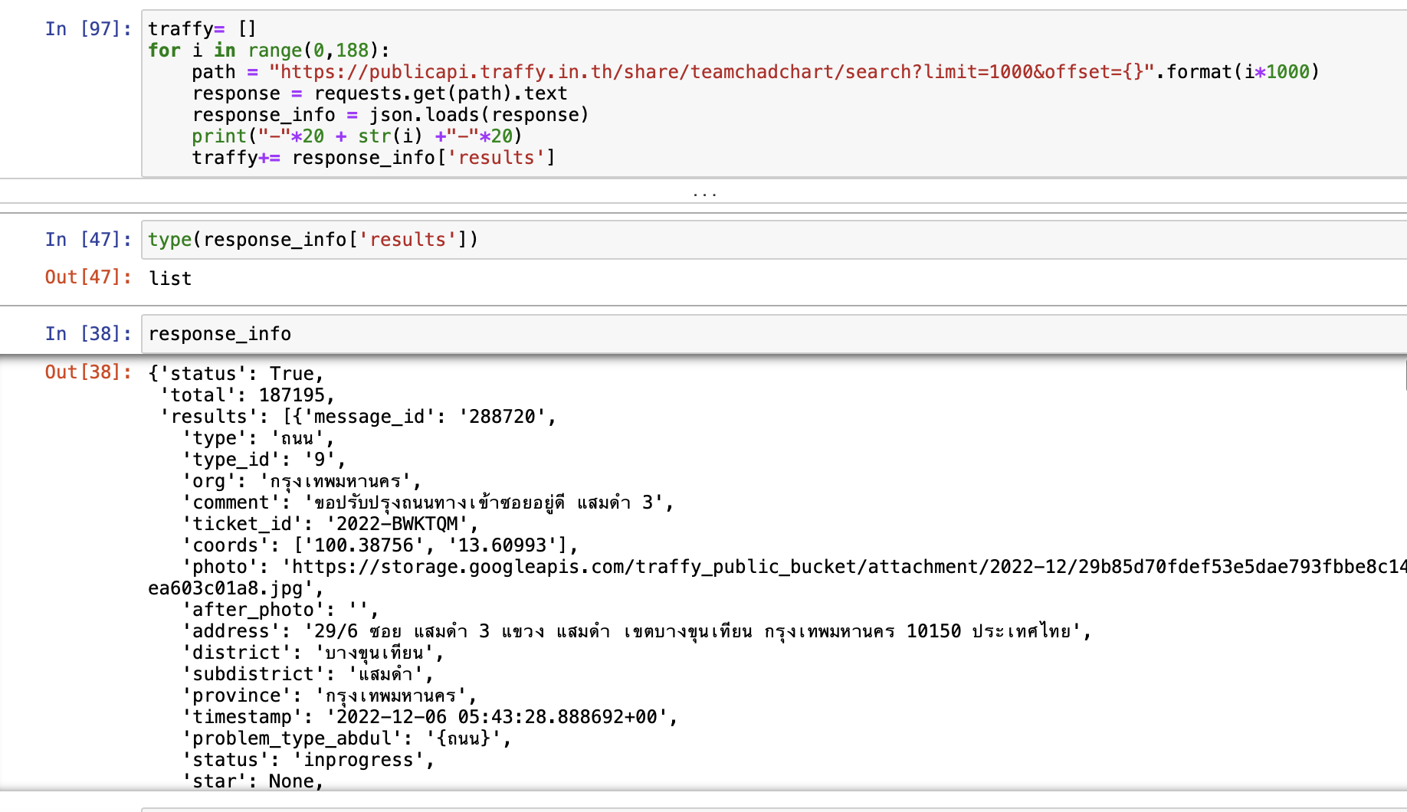
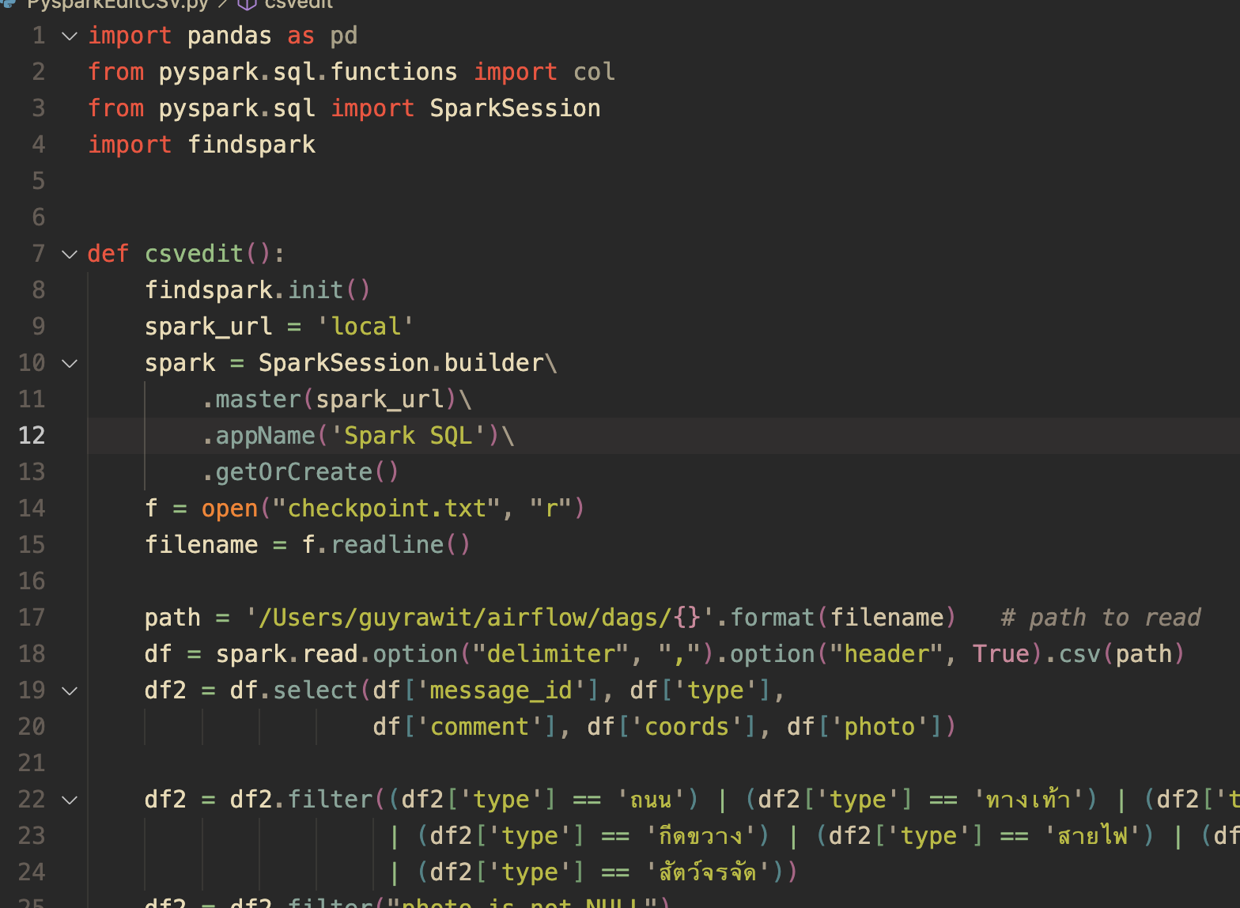
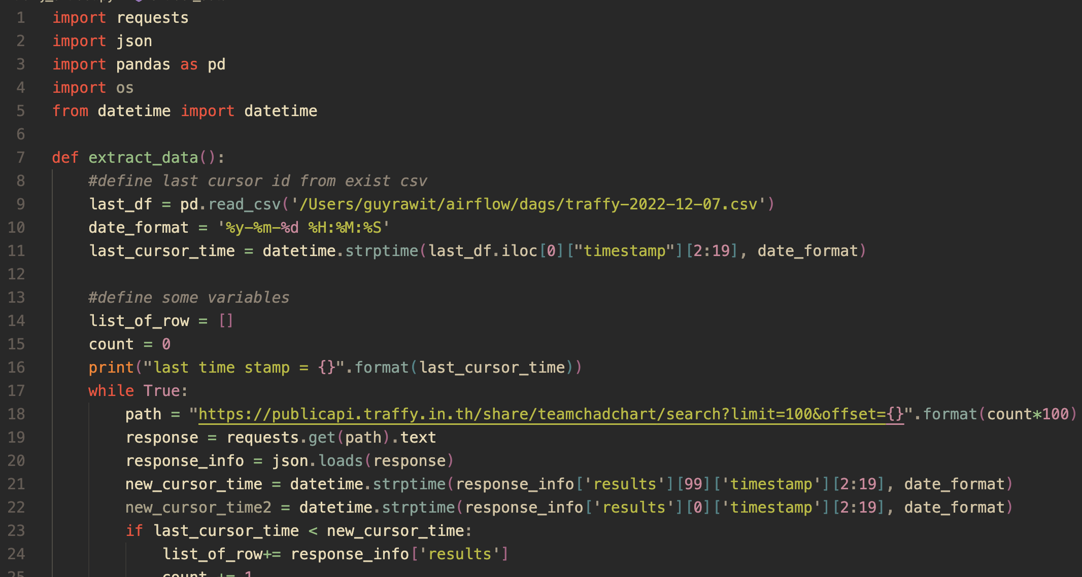
Jupyter notebook -> Python script

Slide 6
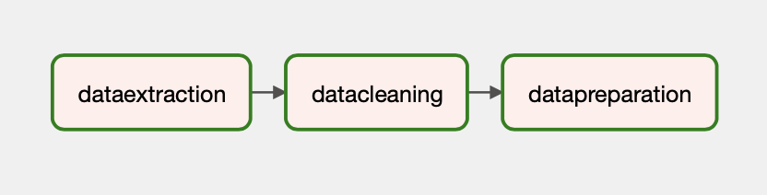


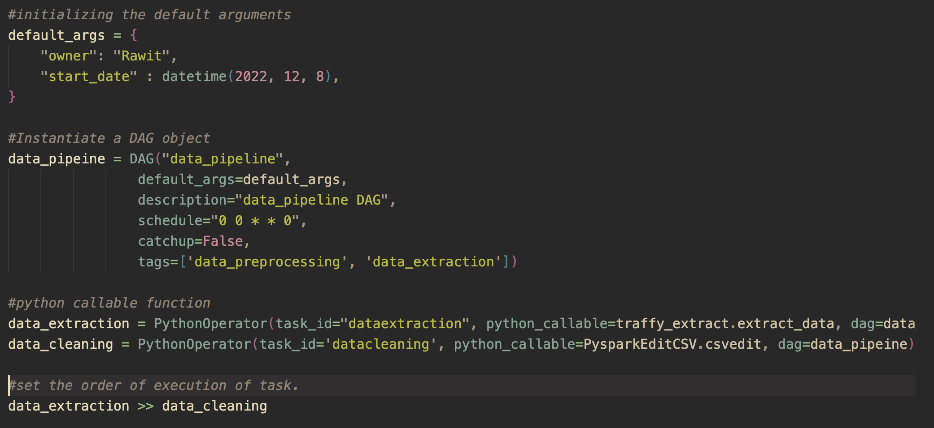

Data Pipeline & Flow Automation
Repeat every week on Sunday by using airflow schedule
Save to local

